Slide 1
RSTMH Global Research in Progress
20 November 2025

Slide 2


Menstrual Hygiene Management in Emergencies: Case Study of Cyclone Freddy Affected Communities in Malawi
Presenter: Priscilla F. Chingamtolo
Co-authors : R.D Malolo, S. Tomoka, A.C. Mjojo
#RSTMH2025 | RSTMH.org

Slide 3
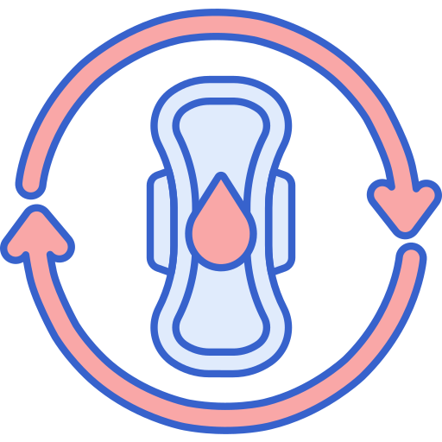
BACKGROUND
Menstruation often causes cramps, fatigue, and mood changes (UNICEF, 2019).
It is surrounded by stigma and taboos (Sommer et al., 2015).
Menstrual Hygiene Management (MHM)-using clean materials, changing in privacy, washing with soap, and having proper disposal (UNICEF, 2019).
WHO highlights MHM as a key part of WASH, needing proper facilities, products, and education (WHO, 2022).
#RSTMH2025 | RSTMH.org
Notes:
A natural process in women and girls. Despite being normal, stigma and taboos surround it, hence the need that MHM must be priotised to protect dignity, health, and gender equity in emergencies or otherwise.

Slide 4
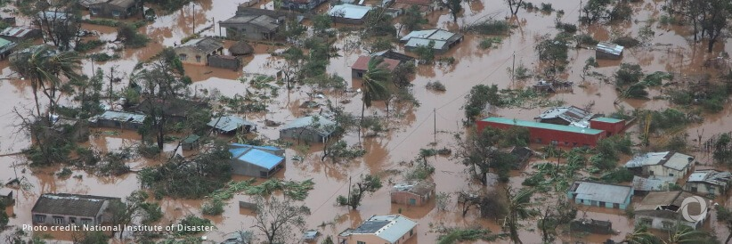
BACKGROUND CONT…
Cyclone Freddy affected >500,000 people with 30,000+ women of reproductive age impacted (DoDMA, 2023).
Limited research on MHM needs in emergencies (Sommer et al., 2016; Sommer et al., 2018; Van Leeuwen & Torondel, 2018; Patel et al., 2022).
Delivering effective interventions requires clear, context-specific guidelines.
Hence the need to understand MHM challenges within the Malawian context.
#RSTMH2025 | RSTMH.org

Slide 5


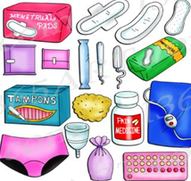
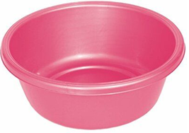
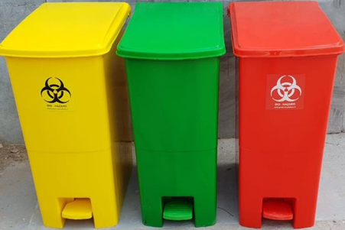
STUDY AIM & OBJECTIVES
Aim:
To gain a comprehensive understanding of the challenges and gaps in MHM experienced by menstruating women and girls.
Objectives
Assess the accessibility of safe water and soap for menstrual hygiene.
Identify available MHM products and supportive items.
Assess the availability of safe and private disposal facilities for menstrual waste.
Assess the effects of the MHM challenges experienced by menstruating women and girls.
#RSTMH2025 | RSTMH.org

Slide 6
METHODOLOGY
Study design
  Cross-sectional, mixed-methods
Study sites
  Blantyre, Mulanje, Chikwawa
Participants
  443 women & girls, 6KIIs, 2FGDs, 6IDIs
  Multistage for household survey + purposive for KIIs/FGDs
Sampling
Data collection
  Structured questionnaire, KIIs, FGDs, Interviews
Language & sensitivity
  Chichewa, female enumerators
Data analysis
  SPSS, Excel, thematic analysis
#RSTMH2025 | RSTMH.org

Slide 7
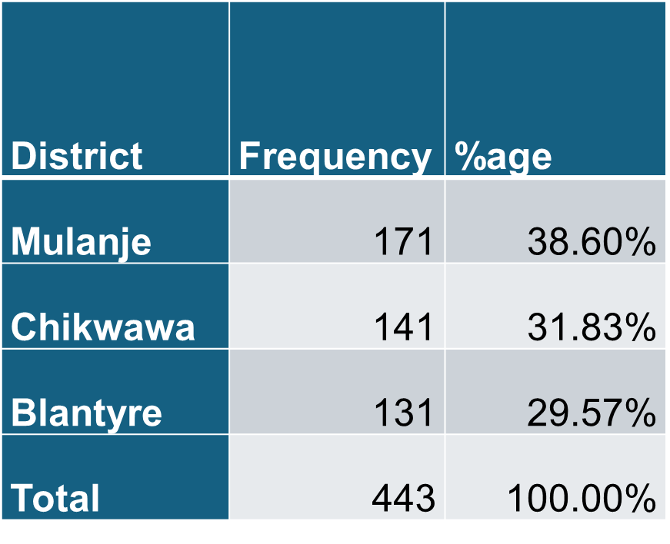
RESULTS
Demographics
#RSTMH2025 | RSTMH.org

Slide 8
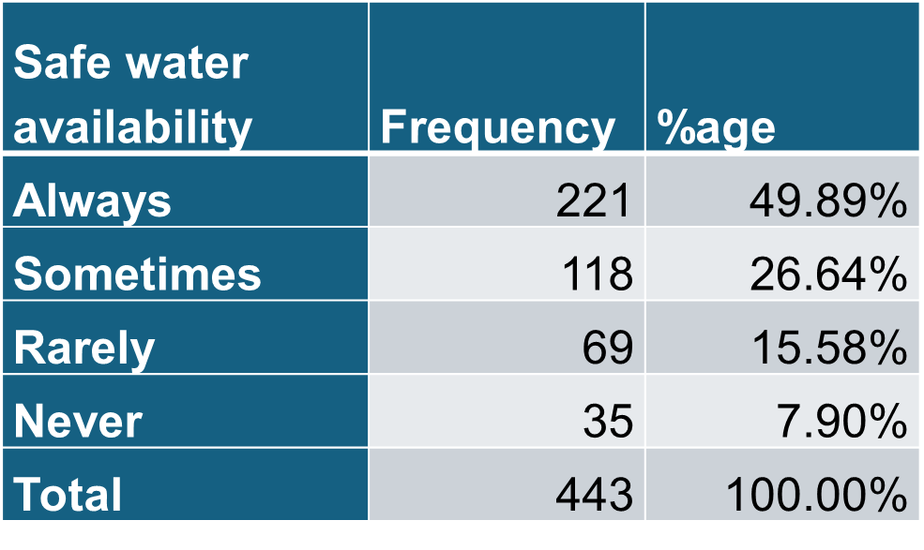
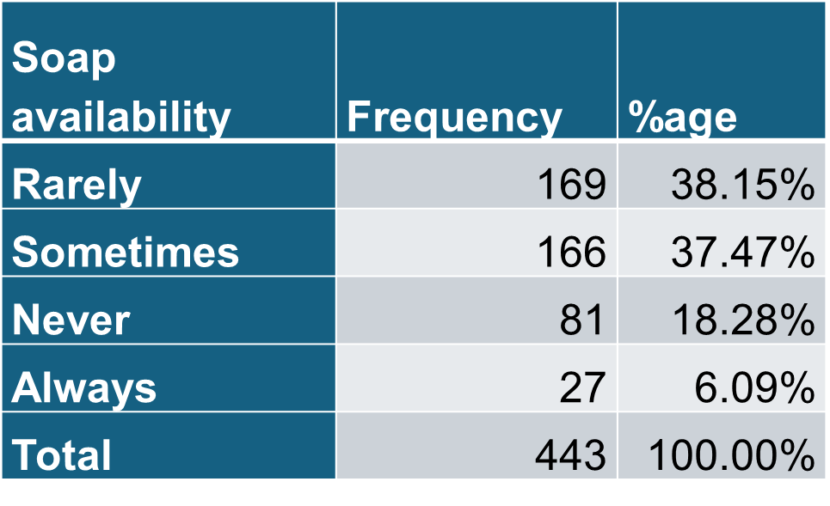
RESULTS CONT…
Access to Water and Soap
“Without soap, I had to use water alone, which didn’t feel clean or safe.” - Female respondent, Mulanje
- Overcrowding and damaged infrastructure reduced access; causing struggle to keep clean during their periods.
#RSTMH2025 | RSTMH.org

Slide 9
RESULTS CONT…
Available MHM products
m
FGD female, Mulanje: “The reusable pads we received were not enough for all of us. Many women had to share or improvise with cloth.”
#RSTMH2025 | RSTMH.org
Notes:
“The cultural beliefs/misconceptions (social constructed beliefs) like some would say the sanitary pads bring cancer, so it was hard to convince the people to use these sanitary pads.” Female KII respondent

Slide 10
RESULTS CONT…
Support items and facilities
“There was no private place to change… we had to wait until dark or use broken toilets.” - FGD, Chikwawa
#RSTMH2025 | RSTMH.org

Slide 11
RESULTS CONT…
Safe and private disposal facilities
“We buried or burned our used materials… there were no designated disposal areas.” - Woman, Mulanje
#RSTMH2025 | RSTMH.org

Slide 12
RESULTS CONT…
Effects of the MHM challenges
increased stress during menstruation
restricted movement during periods
reduced participation in daily activities
social stigma
"One would be tensed when menstruating since there was no way to manage it properly." – Respondent
"There were no private change rooms, no soap, and no support. It felt like we were not considered." - Respondent
#RSTMH2025 | RSTMH.org
Notes:
Lack of soap and proper washing facilities made reusable products difficult to manage. In other emergencies, this has put women at risk of infection and discomfort.
These reflect how emergencies worsen existing gender inequalities.

Slide 13
CONCLUSION
Access to soap remained limited despite nearly half having safe water, undermining proper hygiene.
Reliance on cloths due to limited product availability; supportive items like underwear inadequate.
Disposal facilities were lacking, leading to undignified practices like burning or burying materials.
MHM challenges caused stress, movement restrictions, reduced participation in social life and social stigma.
Reinforces the need to strengthen integration of MHM into emergency planning, linking it to health, dignity, and gender equity.
#RSTMH2025 | RSTMH.org
Notes:
The study revealed serious gaps in MHM during the Cyclone Freddy.

Slide 14
RECOMMENDATIONS
Strengthen coordination and integrate MHM into long-term resilience.
Pre-position MHM Kits - culturally appropriate with community input.
Ensure gender-sensitive sanitation with private spaces for changing, bathing, and disposal.
Allocate specific budget lines for MHM.
Raise awareness on stigma-reduction.
#RSTMH2025 | RSTMH.org

